Slide 1


IEDA4500: Final Project
Robo Advising for Retail Investor
Kwok Ho Kai, Kyro 2024/05
Notes:
Good afternoon professor, ta and students, I am Kwok Ho Kai Kyro. Today I bring the topic of Robo Advising for Retail Investors as my final project presentation.

Slide 2
Agenda
1
Introduction
2
Methodology
1
Characteristics of robo advising and retail investors
Project objective
Implementation steps
Data processing workflow
3
Result
4
Summary
Evaluation of the performance and stability of the robo advising
Limitation
Further Improvement
Conclusion
Notes:
In the coming time, I will explain what is robo-advsing and retail investors. What my project want to archive and how I implement the project and the share the result and the summary.

Slide 3




Background
Robo-Advisors
Traditional Advisors
Expertise
Benefit of Robo-Advisors
Accessibility
Wealth Requirement
Efficiency
Characteristic of Retail Investors
Lack of knowledge
Desire for simplification
Lack of time
Notes:
1: In today world, everyone want to grow their money in the financial markets. But the market is complicated, so they seek helps from the professional advisors to guide their investment decisions. The introduction of robo advising change this way. Robo advisors are algorithm-driven so they operate without human error, but for traditional advisors, there is a possibility of personal biases and emotion influences their judgement. It also require a face-to-face or phone calls that limited the accessibility. Robo-advisors service are 24/7 which making them highly accessible to anyone and bring that they generally have a lower minimum investment requirement. Traditional advisors often rquires a higher wealth which bring a barrier small-scale investors. Robo advising automated processes mean that portfolio adjustments and responses to market changes can be made very quickly. But traditional advisors need time to digest the new information and make the process slower. Therefore, the benefit of robo advising always outweighs to traditional robo advising.
2: Regarding to retail investors. They may have limited knowledge to the market. They dont understand the market concept and dont know how to manage their risk. At the same time, they may not have many times to learn or manage their portfolio actively. They always seek for simple and understandable investment solutions.

Slide 4
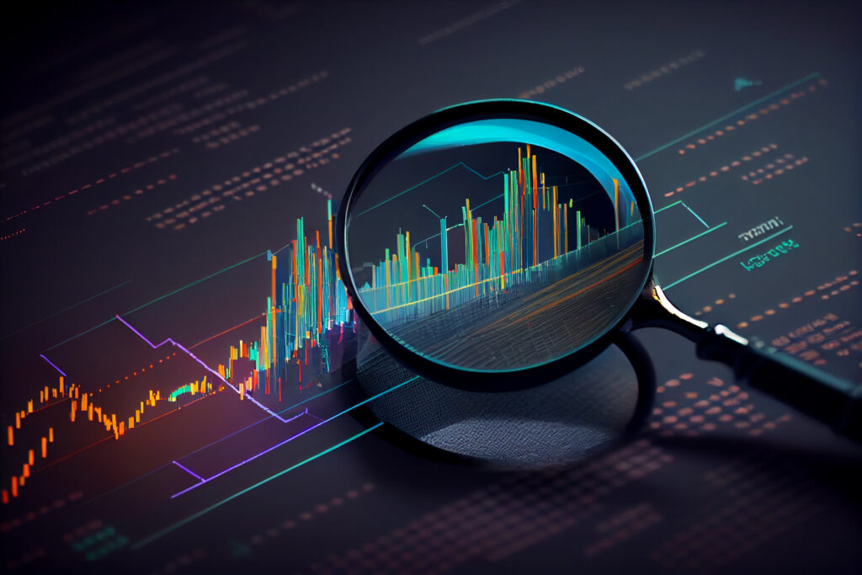
Objective
Data-Driven Strategy Development
Daily Trading Signals
Automated Diversification Investment on ETFs (SPY)
Notes:
These overview bring three objective my project.
1: The first one is to develop a data-driven strategy for advising the retails investors.
2: The second is to offer a simple and straight forward trading signal everyday like long or short or do nothing based on the market updated.
3: The third is to provides advice with the focus on ETF in that will automatically diversify the investor's portfolio and reducing their risk.
Automated Diversification through ETFs:
Objective: Implement a robo-advisor that provides advice on ETFs tracking index funds. This feature will automatically diversify the investor's portfolio across various asset classes and geographic locations, thereby reducing the risk associated with individual stock investments.
Benefit: Retail investors gain exposure to a broad market with a single transaction, which simplifies the investment process, enhances risk management. achieve diversification without the need to research and select individual securities.
Daily Trading Signals:
Objective: Develop a feature within the robo-advisor that offers straightforward trading signals (buy, sell, hold) updated daily based on market analysis and algorithmic forecasts.
Benefit: This helps retail investors make timely decisions without the need to constantly monitor market fluctuations, thus reducing the emotional stress of trading and increasing the potential for systematic returns.
Data-Driven Strategy Development:
Objective: Incorporate backtesting and strategy optimization tools within the robo-advisor to develop and refine investment strategies based on historical data. This will ensure that the strategies are robust and can adapt to changing market conditions.
Benefit: Retail investors benefit from scientifically tested and optimized strategies, increasing the likelihood of achieving higher returns compared to ad-hoc, untested investment methods.

Slide 5
Implementation Steps
Evaluation
Robo Advising
Verify the strategy with performance metrics
Data Driven
All net worth customers
Low human biases
Backtesting & Optimization
Automation
Run simulation
Tune the hyperparameter
Discord Bot API
Google Cloud Function
Function Scheduler
Strategy Development
Script
Quantify the strategy base on mean reversion
Data scraping from internet
Transforming data to signals
Notes:
I break the methodology into six steps.
First develop a strategy, followed by backtesting and tuning the hyperparameter.
Then I will verify the strategy in the out-of-sample testing by performance metrics.
After that, I automate the whole data processing steps by writing the script to scrape the data from internet to make sure the signals could newly be updated to the latest market environment.
And finally I link the script a bot to send the signals to social media so that investors could receive the market information and investment advice from the robot.

Slide 6
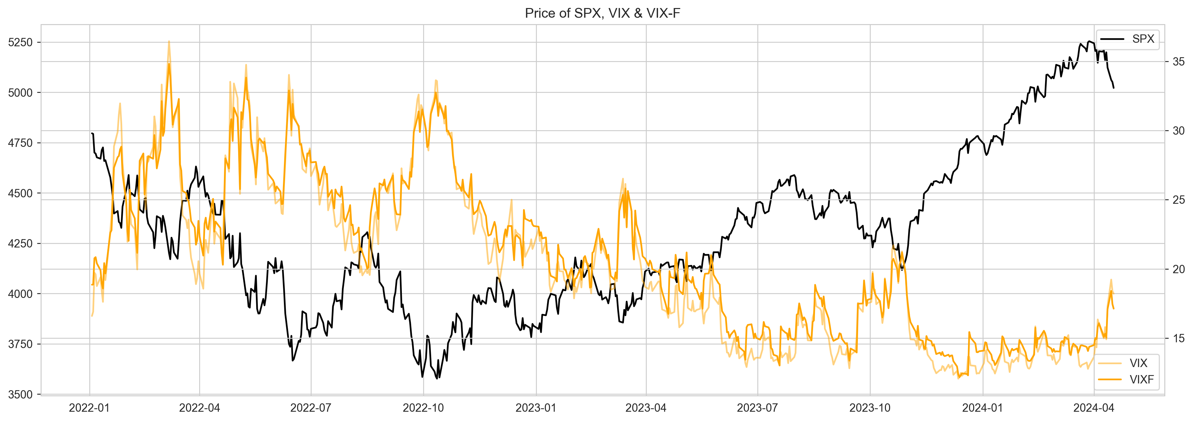
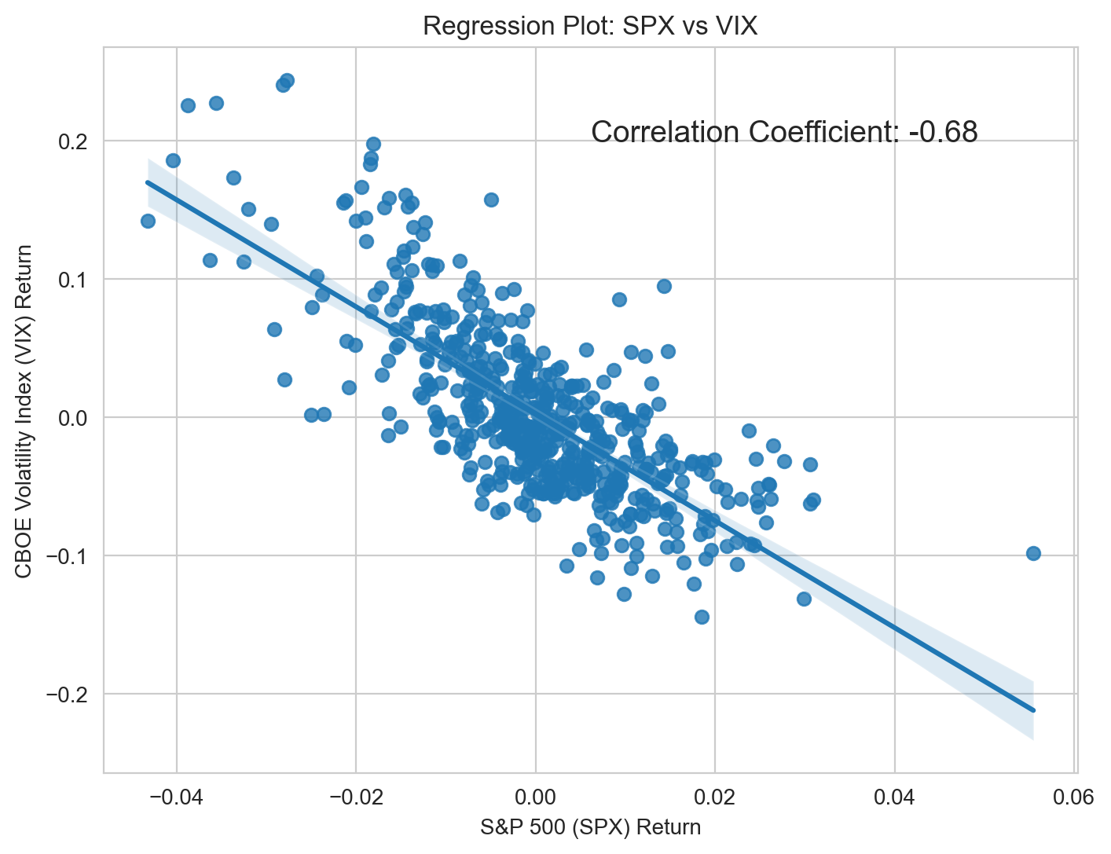
Strategy Development
VIX - CBOE Volatility Index
Volatility expectation of S&P 500 index option, which is not tradable for index but for future
Indicator of market sentiment
Negative correlation with S&P 500
Notes:
Let me start by introducing the VIX index. It is an indicator in the US market to measure the expected volatility of S&P500 call and put option. The index is not tradable for itself but it is tradable for its future. It is also popular know as the market sentiment. As you could see the black line, when the S&P500 dropping, the VIX index is rising. So it is important to noticed that the vix index is negative correlated with the market.
The VIX Index is a measure of constant, 30-day expected volatility of the U.S. stock market, derived from real-time, mid-quote prices of S&P 500® Index (SPX℠) call and put options.
Often known as the "fear index," it represents investor sentiment and expected volatility over the next 30 days. Higher VIX values indicate higher expected volatility and potentially a fearful market.
Typically, the VIX index has an inverse relationship with the S&P 500. When the S&P 500 decreases, the VIX often increases, reflecting increased uncertainty or fear in the market.

Slide 7
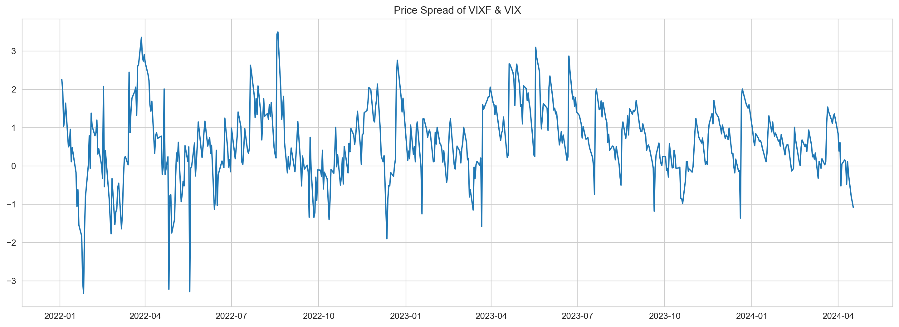
Mean Reversion
Indicator Introduction – Spread
VIXF – VIX
Stationarity of the Spread
Cointegration Test: determines if the spread between the two time series data are constant over time
Null Hypothesis: spread between two time series are non-stationary
P-value is 0.0001: indicates the spread is stationary
Pair | P-Value
SPX&VIX | 0.965
SPX&VIXF | 0.945
VIX&VIXF | 0.0001
Notes:
I introduced an indicator call spread by subtracting the VIX Future to VIX. And the spread is shown as blue line. As you could see when the spread is too high, it tends to reverse and when it is too low, it tends to rebound. So I carry a cointegration test to see if the spread is stationary. I set the null hypothesis that the spread are non-stationary and the p-value is almost 0. So we could conclude that the spread have a mean reverse attribute. [5mins]

Slide 8
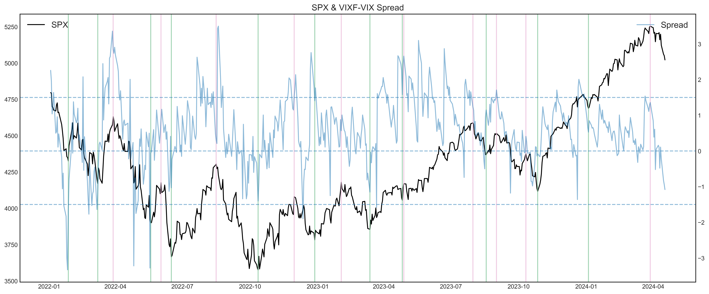
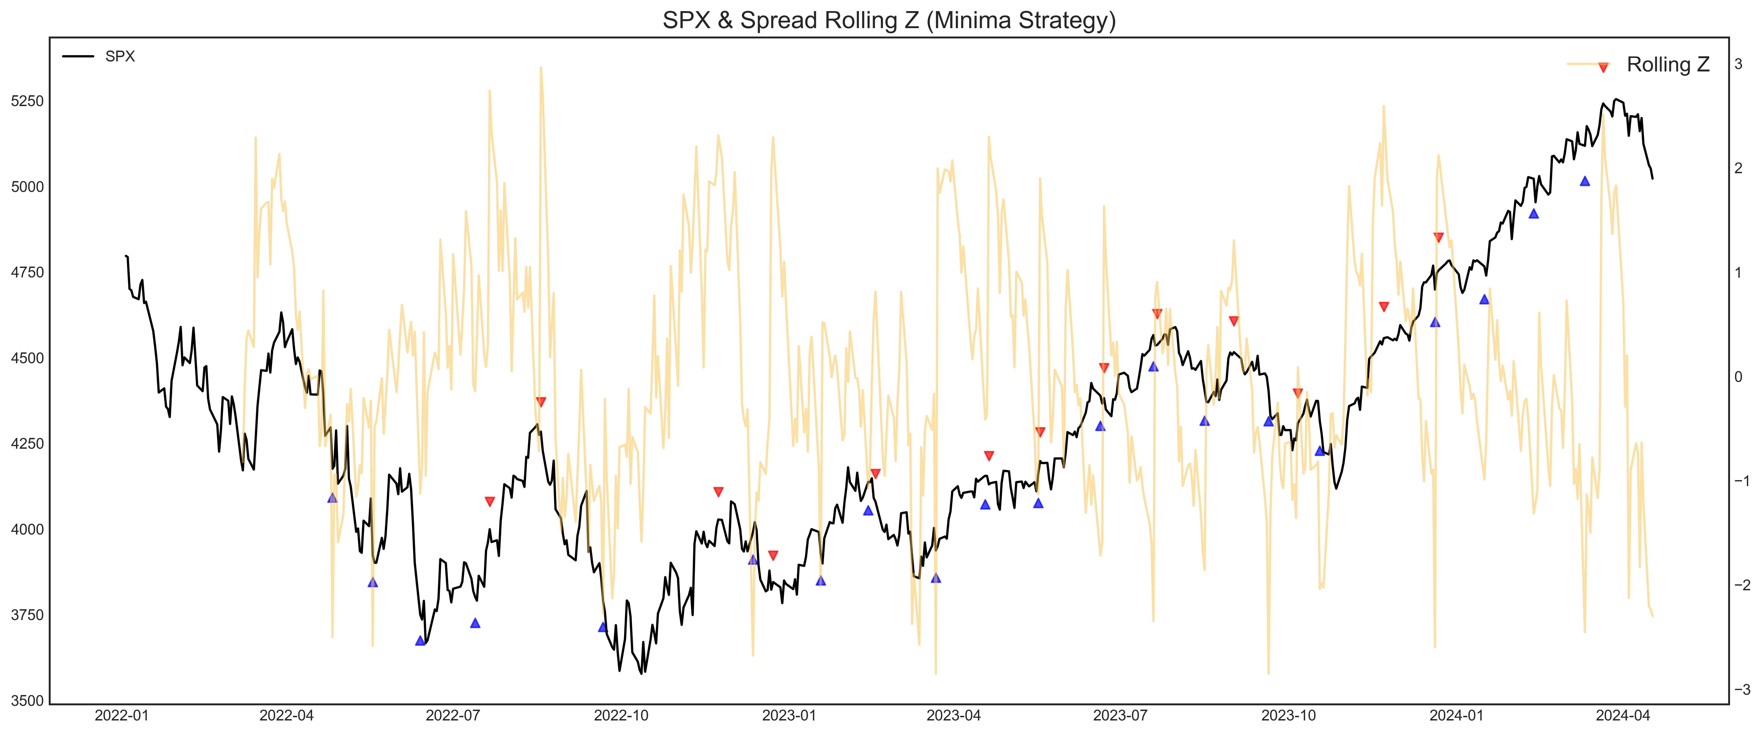
Rationale Behind
Institutional Influence
Following Institutional Flow
Mean Reversion Mechanism
Spread = VIXF – VIX If spread rise, it tends to reverse: Spread↓ <-- VIX↑ <-- SPX ↓
Simple Moving Average (SMA)
Filter out some daily 'noise,' while retaining information
Rolling Z-Score
Capture the concept of relative highs and lows
Without the use of future data
Notes:
1: VIX future is a measure based implied volatility on the S&P 500 option. These products are predominantly traded by professionals such as mutual funds, hedge funds. When these institutions anticipate short-term market volatility, they increase their positions in VIX futures. for hedge or speculation. This is a critical point because these groups of professional are market maker and have a very heavy capital. Not like retail investors, their sentiment and trading decisions can significantly drive market movements. I believe when they fear, it really a signal for short term market movement.
2: So when the VIX future rise and the spread is enlarged, historical data shows it tends to revert to the mean over time and suggests VIX index is going to rise. This indicates is market is going to drop based on the inverse relationship between the VIX and the S&P 500. As you could see in the graph, when the black line is the S&P500 price and the blue line is the spread. When we look back market peak where the spread also is relatively high and the market start to reverse. That observation bring my strategies.
3: I also introduce two indicator to explain the trend of the spread. One is simple moving average to filter out some daily noise while retaining the information. The other is rolling z-score to capture the concept of relatively high and low without the use of future data.

Slide 9
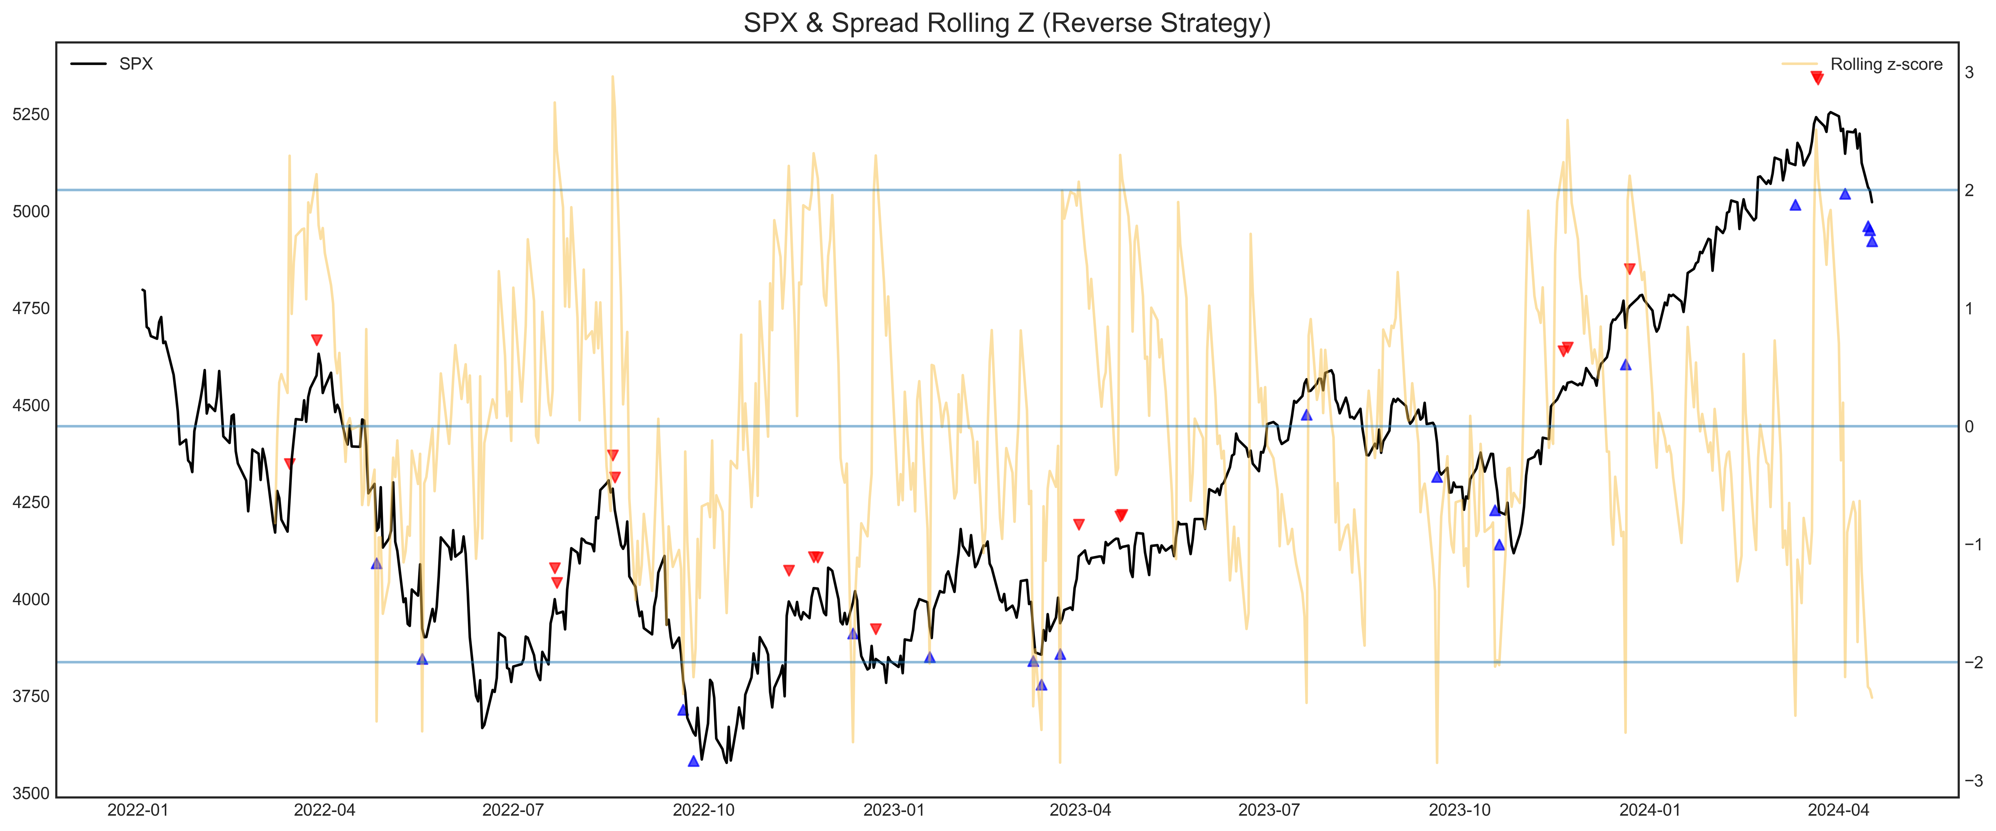
Strategy Explanation
1) Reverse
When the rolling z breaks upper threshold
the spread is relatively high
shorting SPX, vice versa
Hyperparameter
Upper, lower threshold
Holding dates (n)
2) Local Minima
When the local maxima is confirmed
The spread is relatively high
The spread is under downtrend
shorting SPX, vice versa
Hyperparameter
Order (period to confirm the minima)
Holding dates (n)
Notes:
I develop two strategy base on the previous observation and rationale.
1: The first is reverse strategy. When the rolling z score break the upper threshold, it mean the spread is high and tends to reverse so I will short the market and vice versa. which create these 3 hyperparameter.
2: The second is local minima strategy. When the local maxima is confirmed, it mean the spread is under the downtrend so I will short the market and vice versa, which create two hyperparameter. The order means I should refer how many period to confirm a value is a local minima. This is important to ensure the signal is generated without the use of future data.

Slide 10
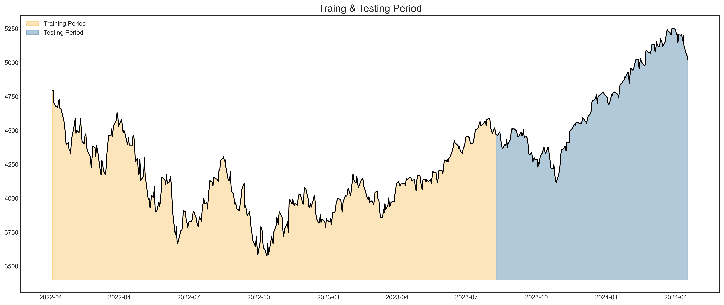
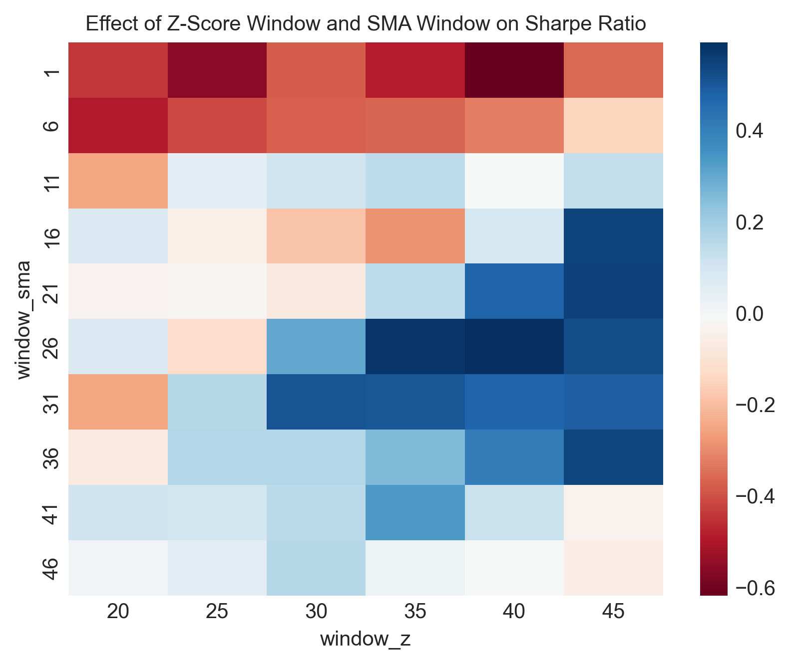
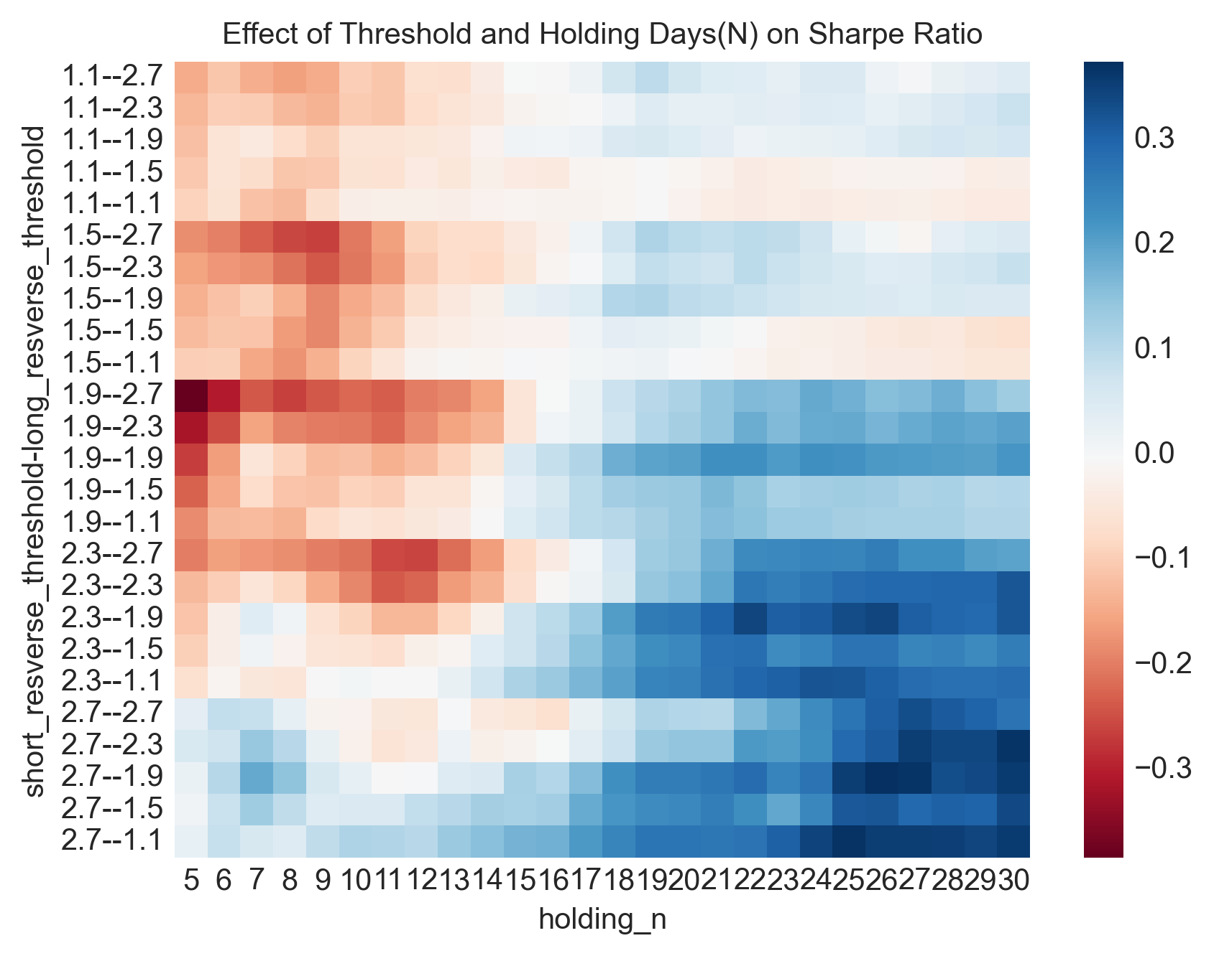
Backtesting & Optimization
Data splitting
70%:30% for training and testing
Employ grid search to tune the hyperparameter in training period
Evaluate the strategy in testing period
Reverse Strategy Backtesting
Performance of upper threshold value is not balanced with lower threshold with following preference:
Long when z-score below -1.9
Short when z-score above 2.7
Successfully eliminate the small SMA windows and Rolling Z-Score window
Notes:
I split the data for training set and testing set.
I employu a grid search technique to carry the analysis hyperparameter sensitivity to the strategy performance in the training set. The deep blue color mean the strategy could obtain a high sharpe ratio and vice versa. As you could see from the heatmap, we could eliminate some hyperparameter to prevent the strategy underfit. I also when the lower and upper threshold are around -1.9 and 2.7, the strategy work better, but is is unbalanced. I think it is reasonable because US market always have more bullish time than bearish market time. This finding aligns with the fact, and with these threshold the strategy enter long position more easily and enter short position more hard.

Slide 11
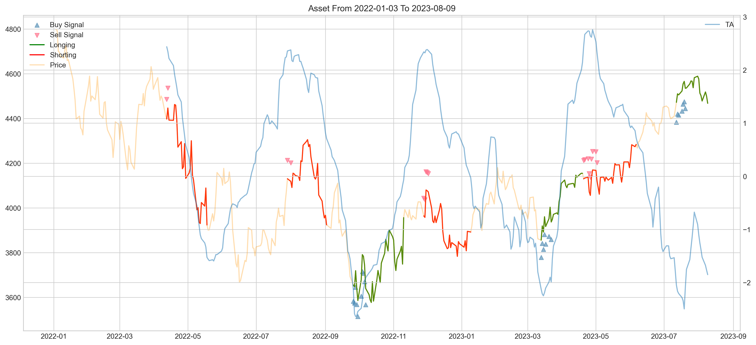
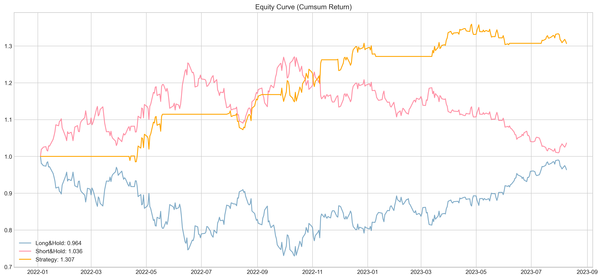
Backtesting & Optimization
Able to capture the reversal timing
Strategy beats the index
Unbiased to the long short preference
Sharpe Ratio | 1.286
Maximum Drawdown | 4.8%
Long Short Ratio | 0.72
Notes:
Here is one of the reverse strategy backtesting sample with the optimized parameter. The strategy could capture the reversal timing and beat the index with its 1.3 sharpe ratio. The long short ratio is around 0.7 and close to 1, which indicate the strategy is unbiased and should be work well no matter the market the bullish or bearish.

Slide 12
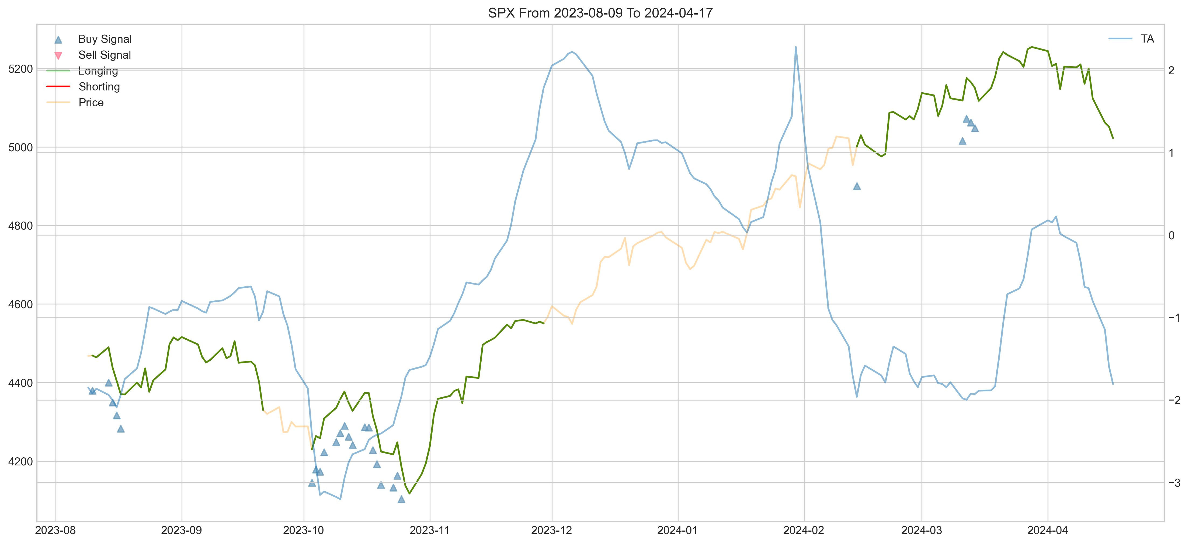
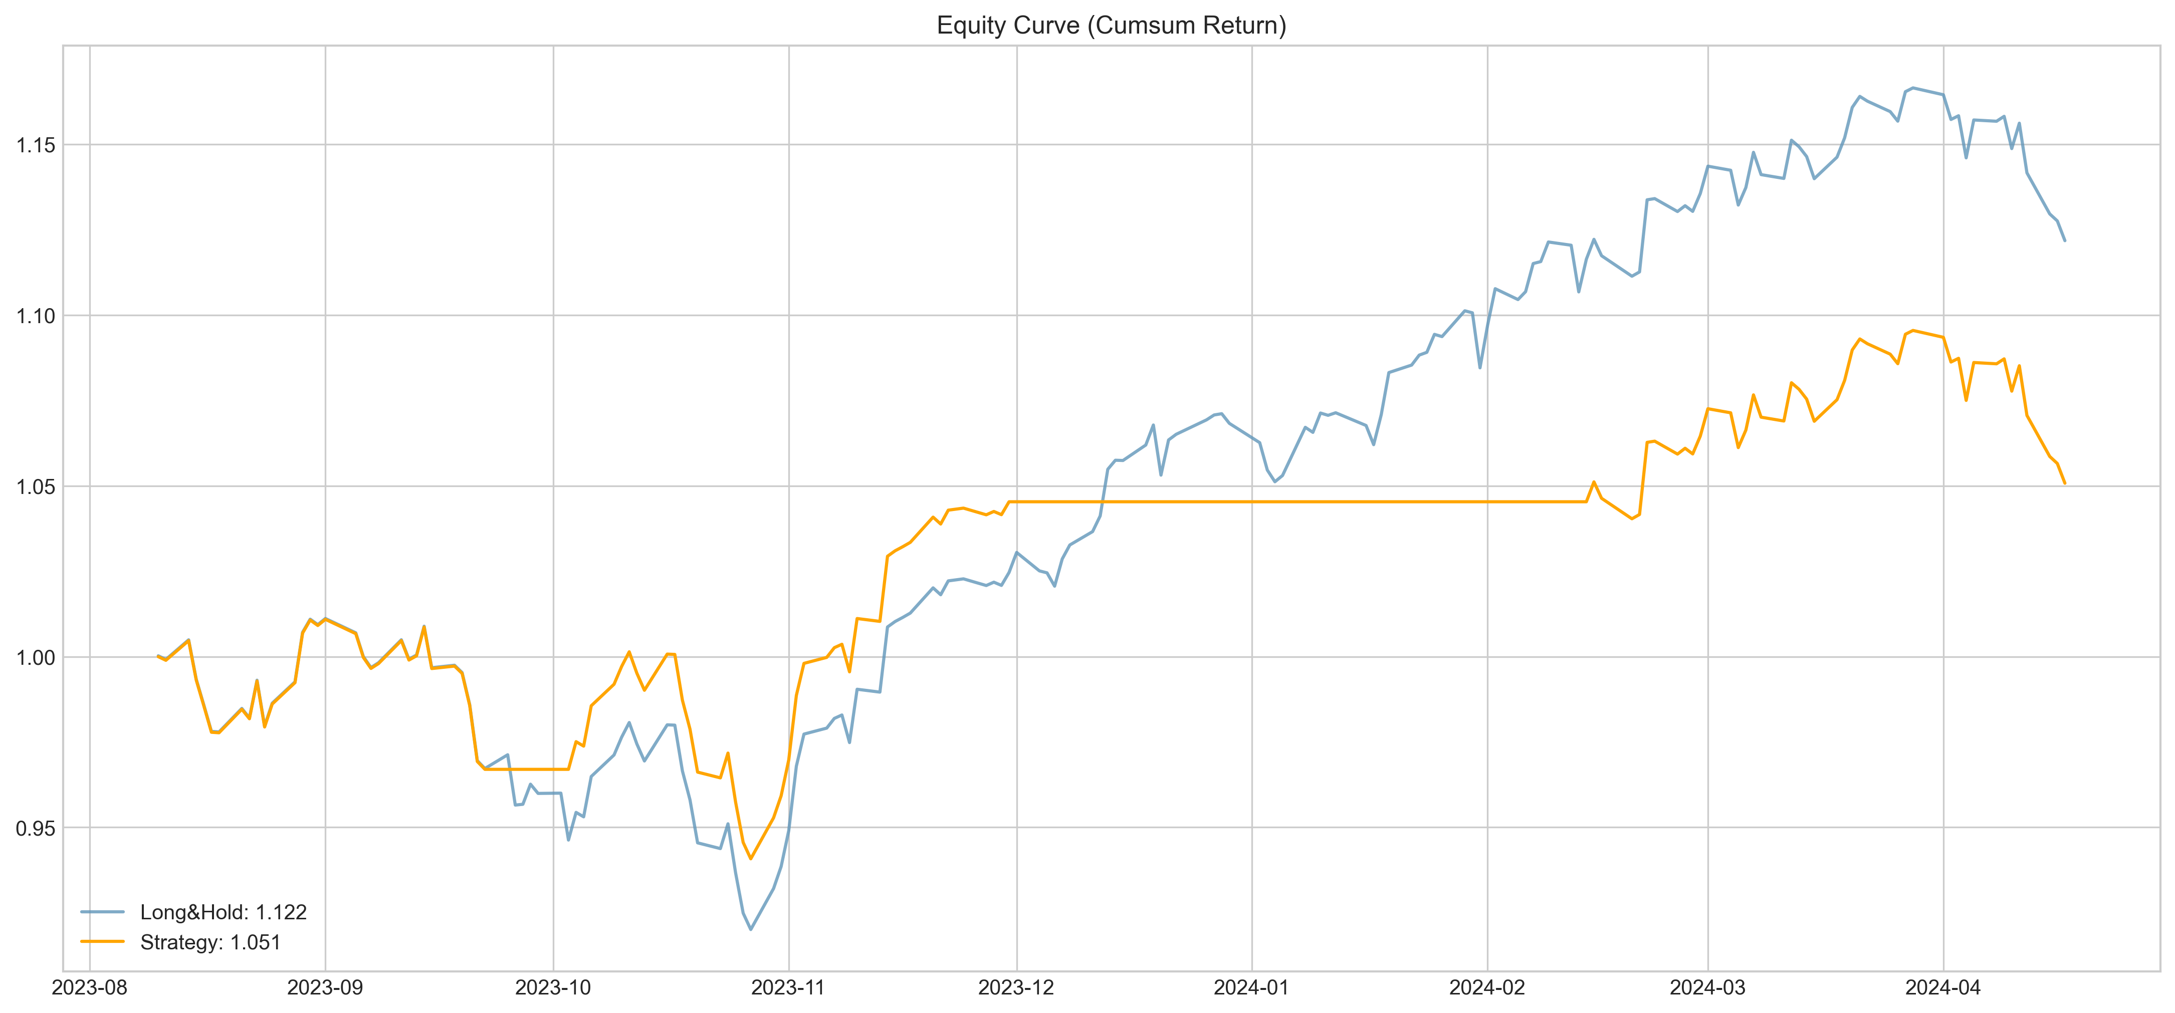
Verification & Evaluation
1) Reverse Strategy
Not losing money but not as promising in training set
Cannot beat the index
Long short biased which unable to capture the downtrend
Sharpe Ratio | 0.743
Maximum Drawdown | 6.94%
Long Short Ratio | inf
Notes:
However, in the testing period, this strategy is not as promising as in the training period. Its sharpe ratio only 0.7 and cannot beat the index. The long short ratio is biased as you could see it could not capture the drawdown.

Slide 13
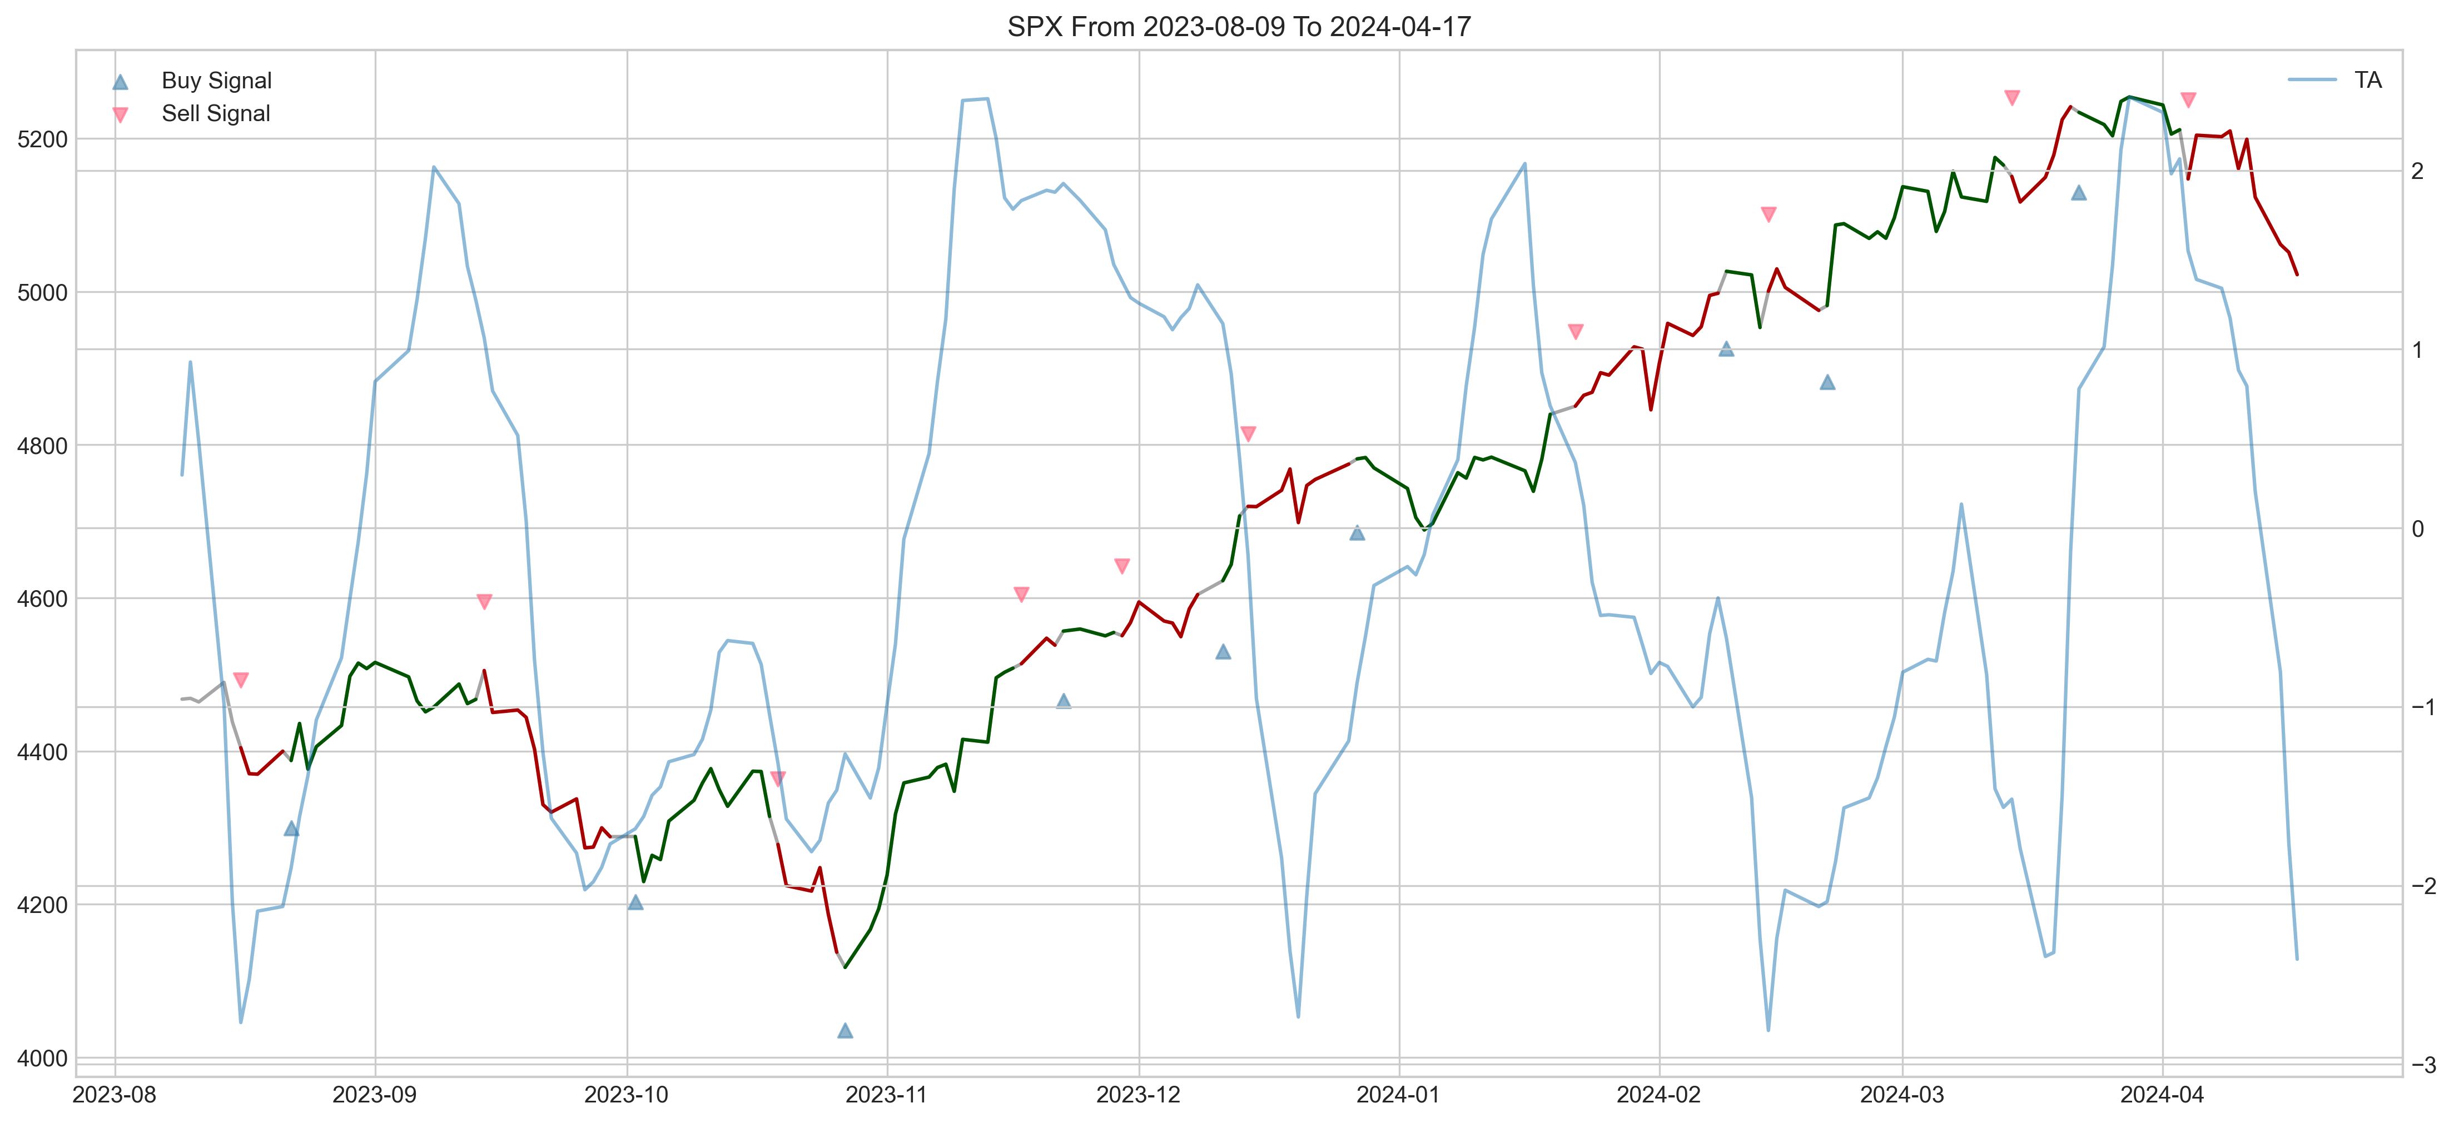
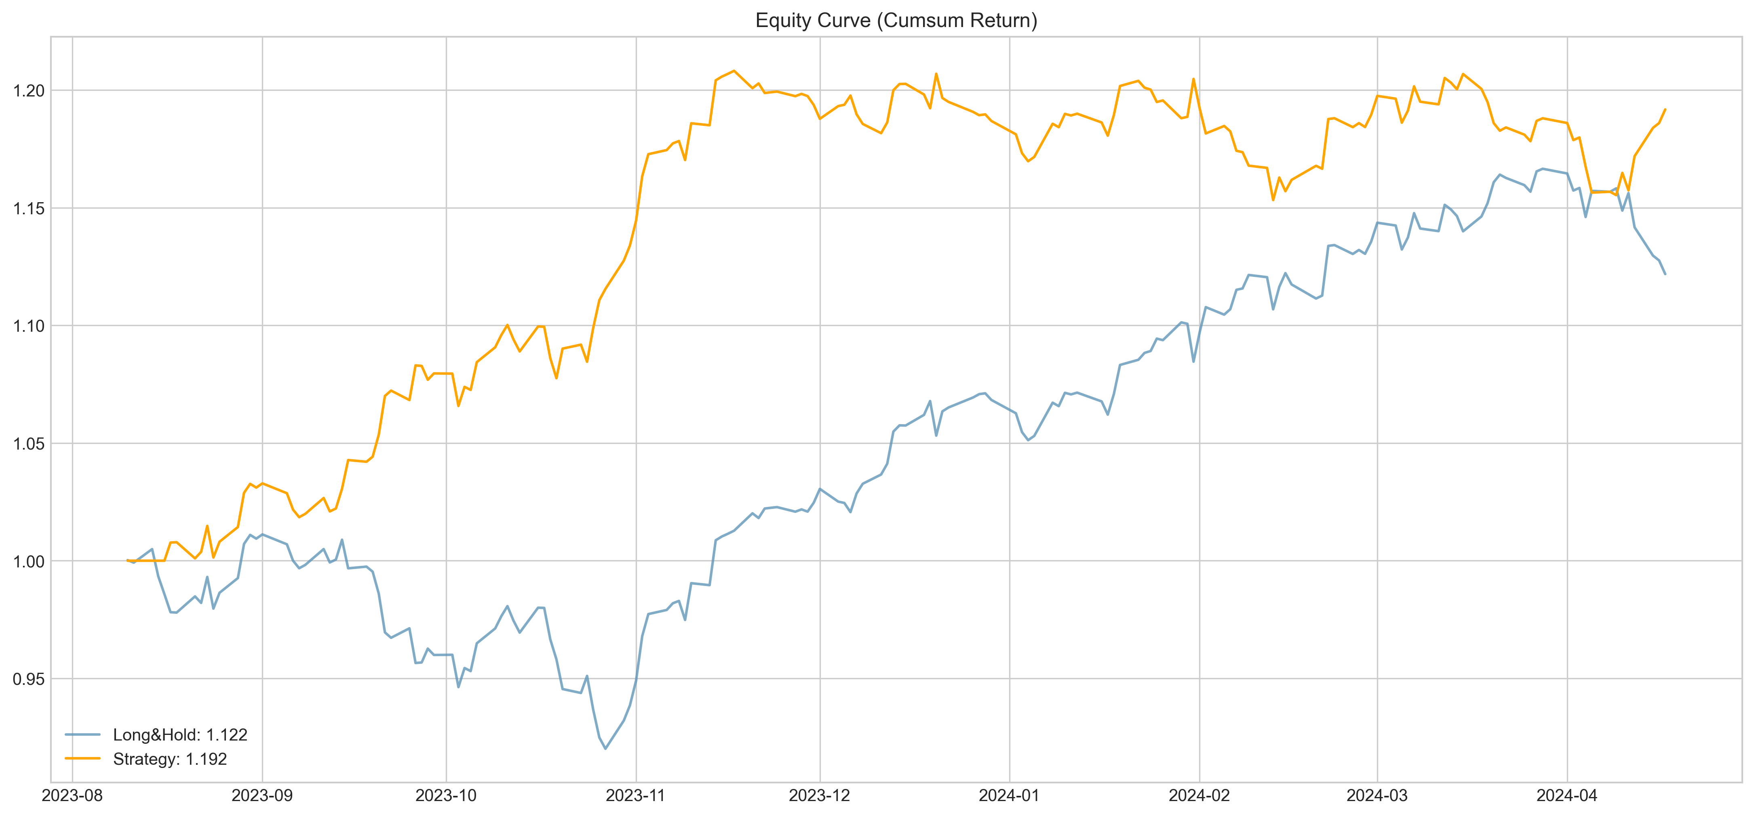
Verification & Evaluation
2) Local Minima Strategy
Archive relatively good performance than the index
Balanced long short ratio, indicated the reliability to both bull or bear market
Sharpe Ratio | 2.40
Maximum Drawdown | 4.55%
Long Short Ratio | 2.35
Notes:
The local minima strategy do better in the testing sample. It archive a 2.4 sharpe ratio to beat the index. The long short ratio is not extremely unbalence. We could see this strategy do well especially it could capture the downtrend in the previous month and adjust the position.

Slide 14



Automate Data Processing
Scrape the data from internet
Send the signal to the social platform (Discord)
1
2
3
Generate the signal base on the strategies logic and optimized hyperparameter
Notes:
Given the backtested and evaluated strategy, I aim to automate whole process from getting the data, generate the signals and send it to the social media.

Slide 15
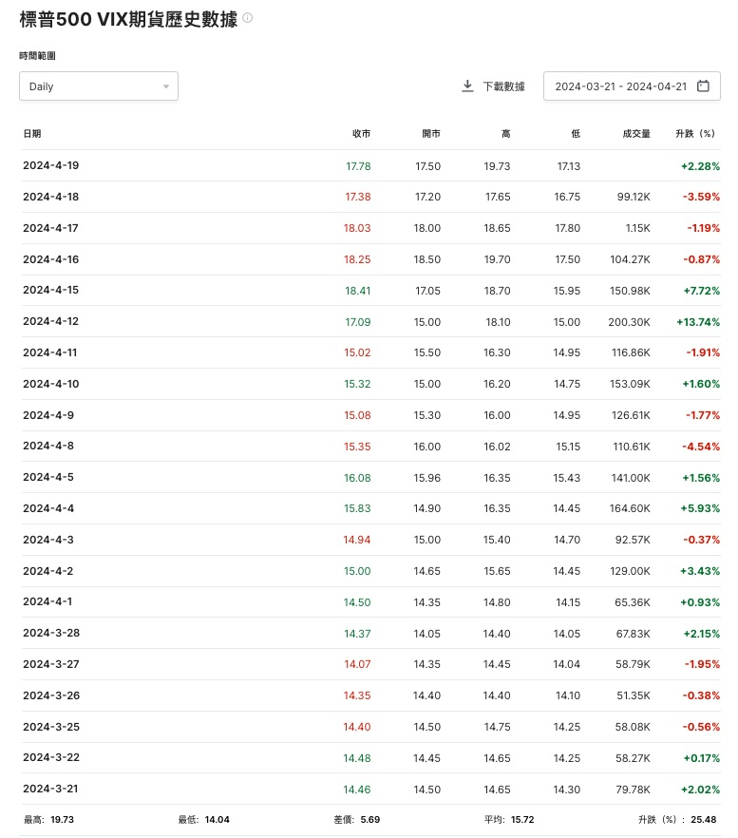
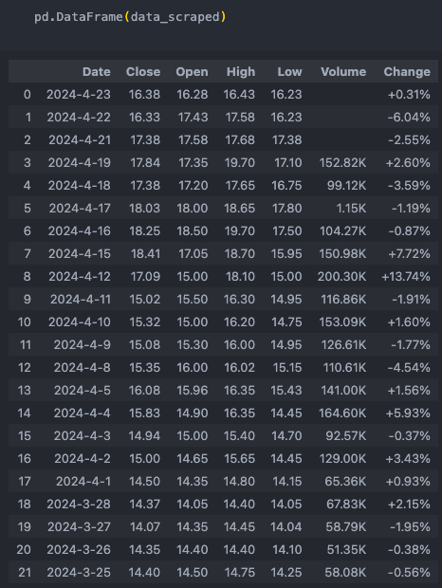
Automate Data Processing
1
2
3
1
2
3
Data Scraping
Use Beautiful Soap to scrape the html data from internet and load it to python in DataFrame format
Investing.hk.com
Notes:
In the first step, I use beautiful soap to scrape the html data from the internet and load it into python dataframe format. The data soruces are from investing.hk.com

Slide 16
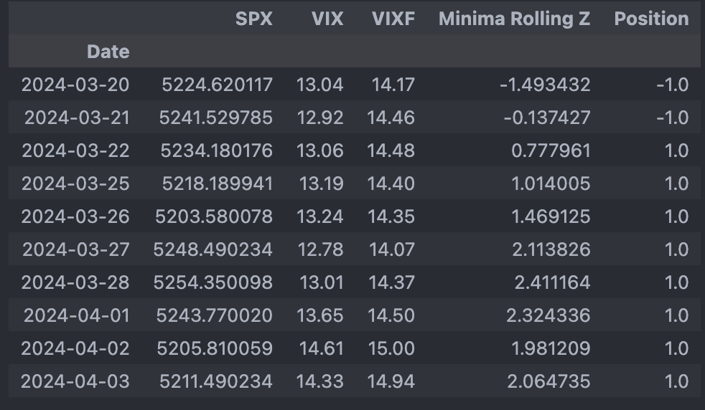
Automate Data Processing
1
2
3
2
Data Transformation
Generate the signal base on the strategies logic and optimized hyperparameter
Calculate the spread
Smoothed the spread with optimized SMA and rolling z-score window
Transformed the indicator into signals base on the strategy logics and hyperparameter

Slide 17
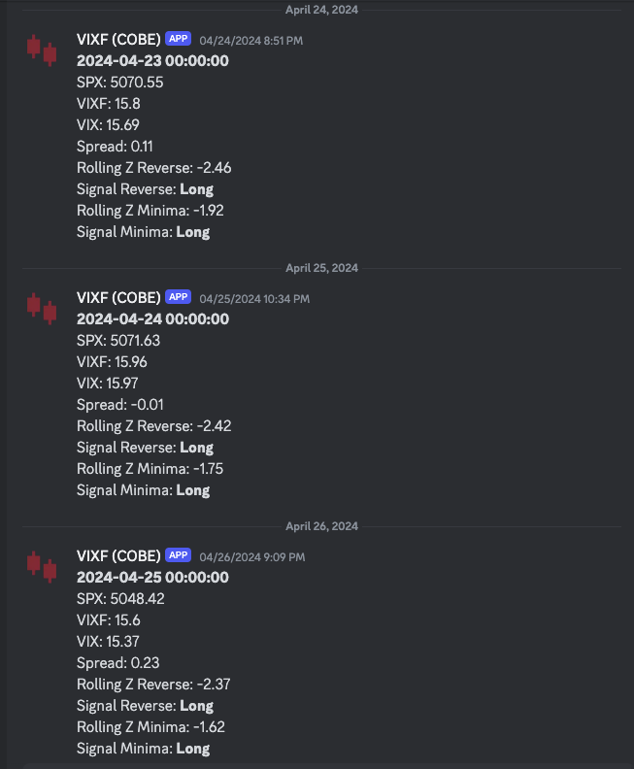
Automate Data Processing
1
2
3
Robo Advising
The scripts are linked with discord bots by its token
Information of the strategy would be sent out to the discord channel by the bot each day before the market open.
Data Including the market data, strategies’ positions could advice retail investors on their investment decisions

Slide 18

Limitation & Improvement
Insufficient Backtesting
Only one sample for backtesting and hyperparameter optimization has been carried out. There is a potential risk of overfitting, even the result is promising
Additional backtesting using rolling-walk sampling or multiple randomized sampling to enhance model robustness and reduce the risk of overfitting.
Limited Underlying Asset
Apply the trading strategy to other underlying assets such as commodities, interest rates, forex, and cryptocurrencies
The strategy has been applied only to the S&P 500 Index (SPX) which may not sufficiently capture broader market dynamics.
Lack of Full Automation
It requires manual force to initiate the run, even the script successfully automates data scraping, signal generation, and robo-advising process.
Implement full automation using job schedular in cloud services to run the job automatically every day.

Slide 19
Conclusion
1
2
3
Importance of Professional Institution Sentiment
Insight of Featuring Engineering on VIX Future
Successful of Robo Advising
The sentiment of professional institutions matters in market movement, at least in trading level and the short term of the market
Reflection of implied volatility and futures products offer valuable insights
Use of SMA and Rolling Z-Score technique highlights the ability of explaining trend
Technology transforms the investment market by utilizing data-driven approach instead of human.

Slide 20
Thank You
For Your Attention

